Slide 1
Project 1: Heart disease diagnosis
Machine Learning: Logistic Regression
Project build under the guidance of Professor Nitesh Karmakar
Machine Learning Mentor(KSI)

Slide 2
Facts
Every day, the average human heart beats around 100,000 times, pumping 2,000 gallons of blood through the body. Inside your body there are 60,000 miles of blood vessels.
The signs of a woman having a heart attack are much less noticeable than the signs of a male.
World Health Organization has estimated that four out of five cardiovascular diseases(CVD) deaths are due to heart attacks.

Slide 3
The prediction of heart disease is considered one of the most important topics in health domain.
Also,
The amount of data in the healthcare industry is huge.
With the machine learning algorithms and having large amounts of data, it is possible to extrapolate information that can help doctors make more accurate predictions.

Slide 4
Dataset
The dataset is a CSV(comma separated value) having 303 rows × 14 columns
Amongst that 14 column, there are 13 features and 1 labelled output column.
Each feature and it’s significance is discussed in the next slide.

Slide 5
Heart disease describes a range of conditions that affect your heart.
Age: The person's age in years
Sex: The person's sex (1 = male, 0 = female)
Chest Pain/Angina: The chest pain experienced
Value 1: typical
Value 2: nontypical
Value 3: asymptomatic
Value 4: nonanginal
RestBP: The person's resting blood pressure (mm Hg on admission to the hospital)
Chol: The person's cholesterol measurement in mg/dl
Fbs: The person's fasting blood sugar (> 120 mg/dl, 1 = true; 0 = false)
RestECG: Resting electrocardiographic measurement
0 = normal
1 = having ST-T wave abnormality
2 = showing probable or definite left ventricular hypertrophy by Estes' criteria

Slide 6
MaxHR: The person's maximum heart rate achieved
ExAng: Exercise induced angina (1 = yes; 0 = no)
Oldpeak: ST depression induced by exercise relative to rest ('ST' relates to positions on the ECG plot.
Slope: the slope of the peak exercise ST segment
Value 1: upsloping
Value 2: flat
Value 3: downsloping
Ca: The number of major vessels (0-3)
Thal: A blood disorder called thalassemia
Value 1: normal
Value 2: fixed defect
Value 3: reversible defect

Slide 7
Understanding the code
Understanding how to approach this Machine Learning Model

Slide 8
Importing libraries
Importing Dataset and Read the data (from csv)
Identify the dependent and independent variables.
Check if the data has missing values or the data is categorical or not.
Visualize the data.
Now split the data into the groups of training and testing for the respective purpose.
After splitting data, fit it to a most suitable model.
Prediction
Model Evaluation

Slide 9
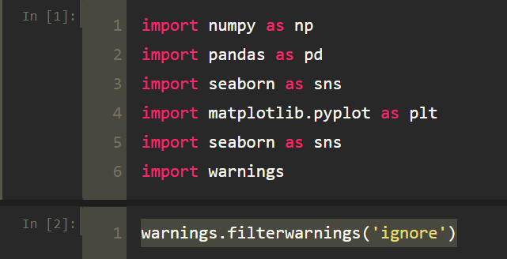
Importing Libraries

Slide 10
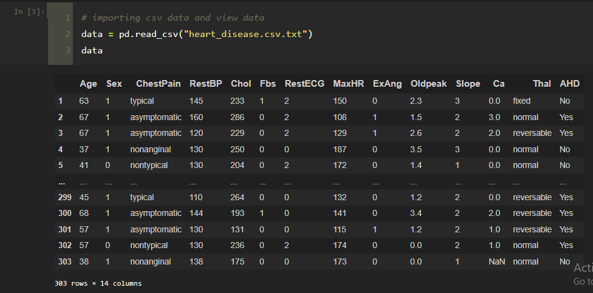
2. Importing Dataset and Reading the data

Slide 11
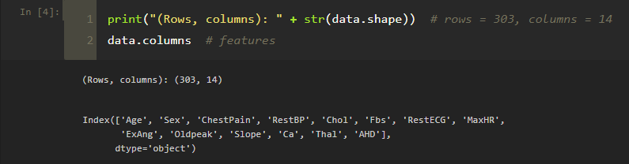
Checking rows and columns

Slide 12
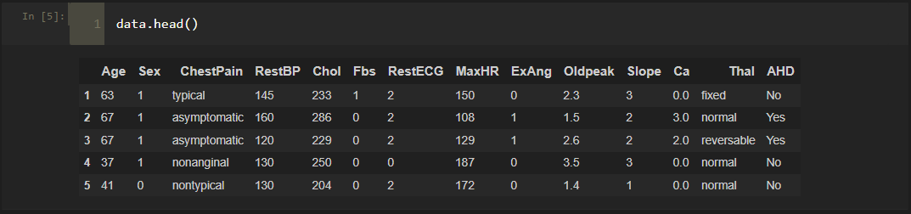
Checking first 5 values from the imported dataset

Slide 13
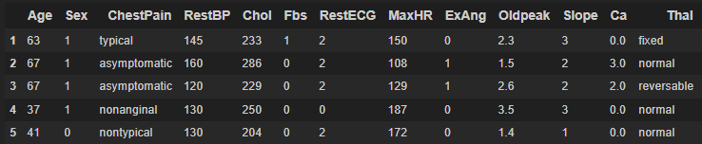

3. Identify the dependent and independent variables.
Dependent Variable:

Slide 14
Dependent variable exists
Since the AHD column exists, which depends on the independent 13 features. Hence, it is dependent variable.
As dependent variable exists, it falls into the category of supervised learning.
Also, the output of the model is either Yes or No. It is a binary classification.
Hence, we will use Logistic Regression for this problem.

Slide 15
Why choose Logistic Regression ?
Logistic Regression is a statistical and machine-learning techniques classifying records of a dataset based on the values of the input fields.
It predicts a dependent variable based on one or more set of independent variables to predict outcomes .
It can be used both for binary classification and multi-class classification
In this project, we have to predict whether the person has heart disease or not, which means, it falls into the category of binary classification(Since, we have to predict- Yes/No).

Slide 16
4. Check if the data has missing values or the data is categorical or not.
Changing string data type to numeric data type:
Data generally needs to be put into numeric form for machine learning algorithms to use the data to make predictions.
Since machine learning model completely works on mathematics and numbers, but if our dataset would have a categorical variable, then it may create trouble while building the model. So it is necessary to encode these categorical variables into numbers.

Slide 17

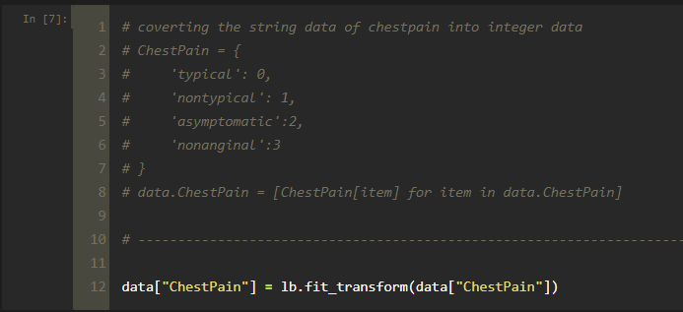

Slide 18
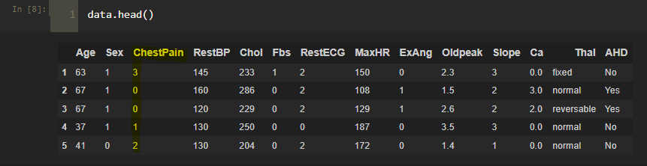
After Label Encoding:

Slide 19
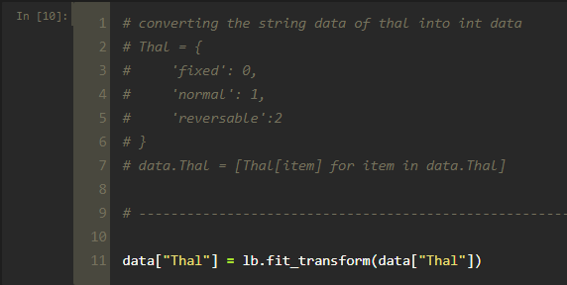

Slide 20
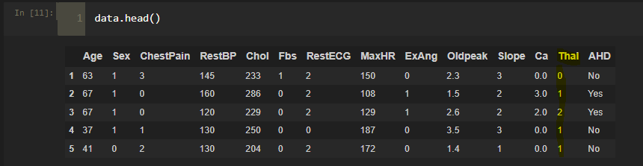
After Label Encoding:

Slide 21
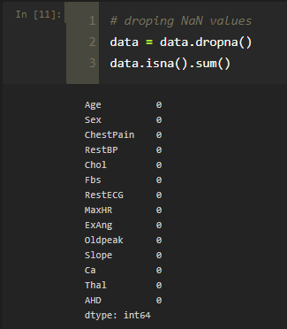
Dropping NaN/Null Values:

Slide 22
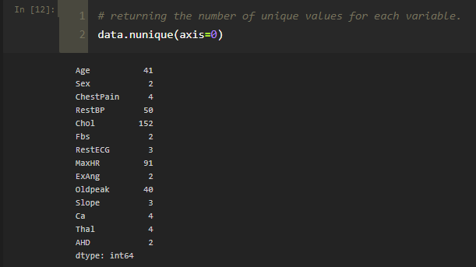
Unique values for each variable:

Slide 23
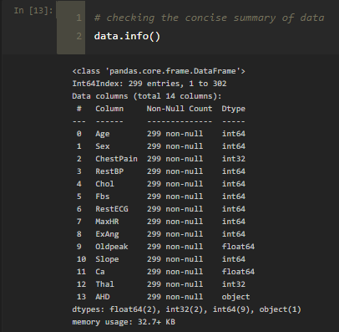
Concise summary of data:

Slide 24
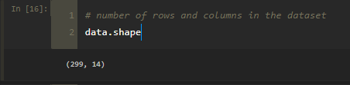
Rows and columns in the dataset after dropping NaN values:

Slide 25
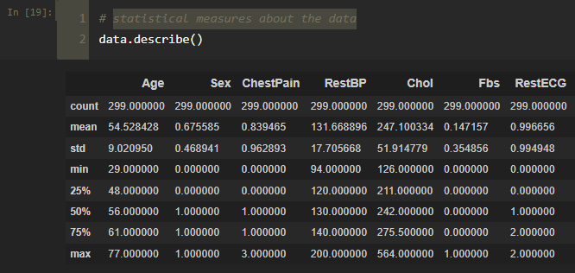
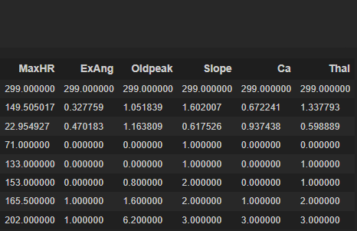
Statistical measures about the data:

Slide 26
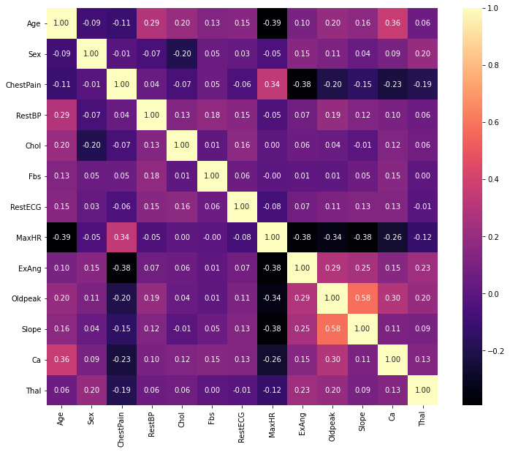
Correlation matrix: Correlation indicates how the features are related to each other or to the target variable.

Slide 27
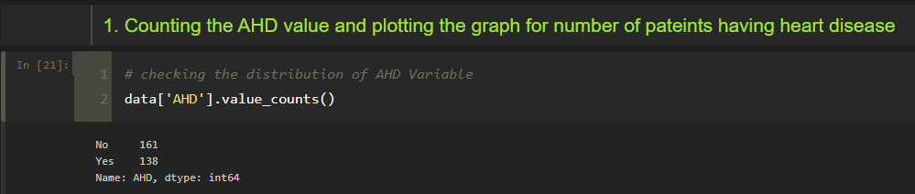
5. Visualizing the data

Slide 28
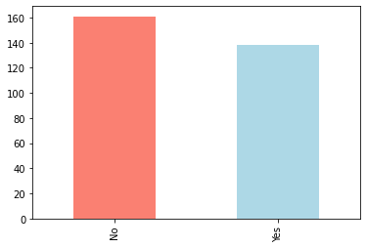
Graph for number of patients having heart disease:

Slide 29
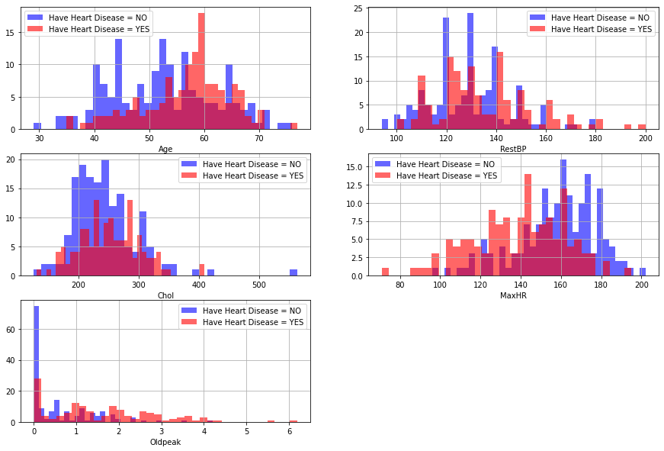
Relation of various attributes with the target:

Slide 30
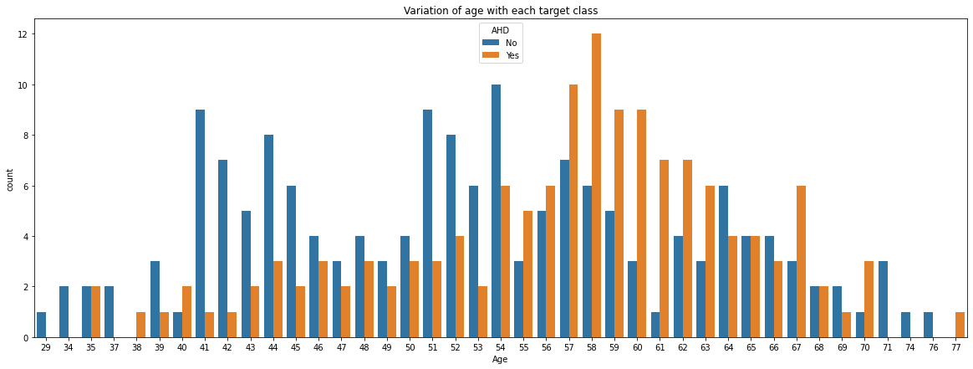

Slide 31
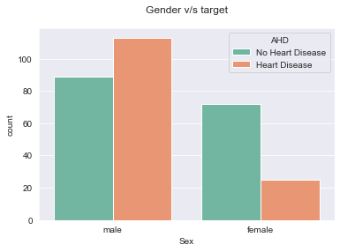
According to this dataset, Males are more susceptible to get Heart Disease than Females.

Slide 32
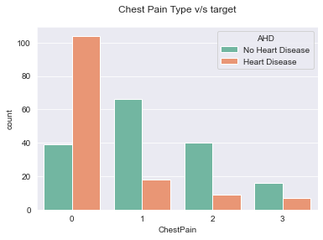
There are four types of chest pain, typical, non typical, asymptomatic and nonanginal.
Most of the Heart Disease patients are found to have asymptomatic chest pain
Value 1: typical
Value 2: non typical
Value 3: asymptomatic
Value 4: nonanginal

Slide 33
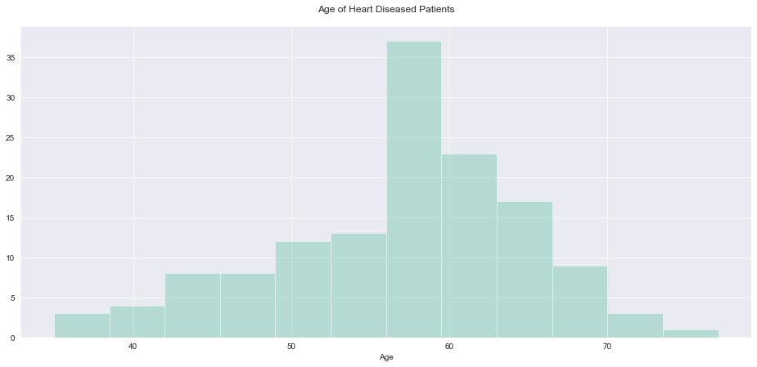
Heart Disease is very common in the seniors which is composed of age group 60 and above and common among adults which belong to the age group of 41 to 60. But it’s rare among the age group of 19 to 40 and very rare among the age group of 0 to 18.

Slide 34

5. Prepare Data for Modeling

Slide 35
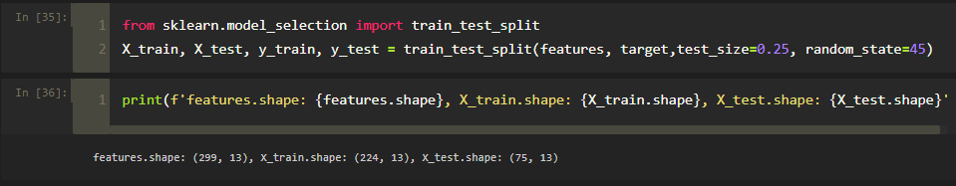
6. Splitting the data

Slide 36
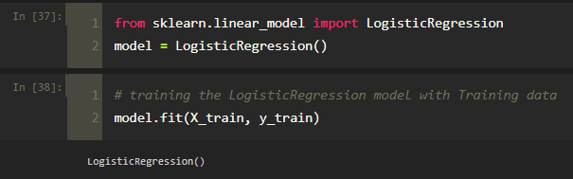
7. Fitting into Model

Slide 37
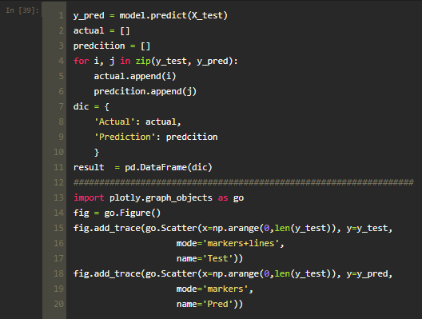
8. Prediction and plotting ‘predicted and actual’ graph

Slide 38
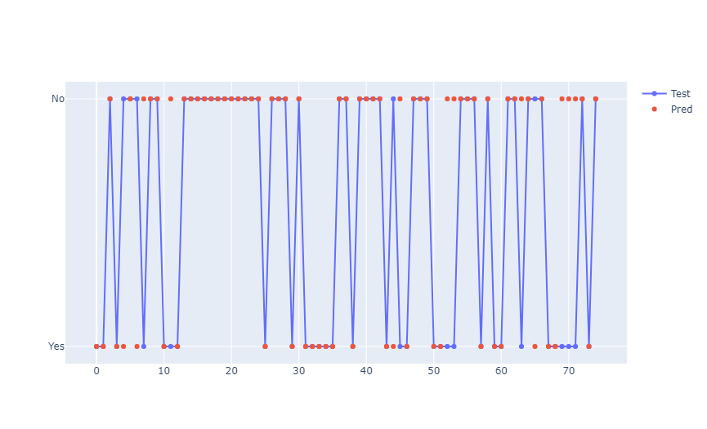

Slide 39
The red dots represent the predicted values that are either 0 or 1 and the blue line & and dot represents the actual value of that particular patient.
In the places where the red dot and blue dot do not overlap are the wrong predictions and where the both dots overlap those are the right predicted values.

Slide 40
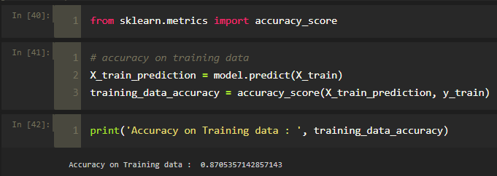
9. Model Evaluation
Accuracy on Training data : 0.8705357142857143

Slide 41
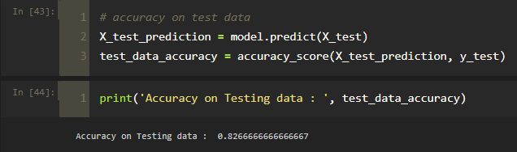
Accuracy on Testing data : 0.8266666666666667

Slide 42
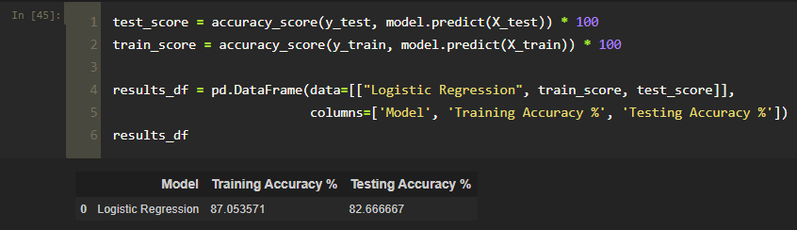

Slide 43
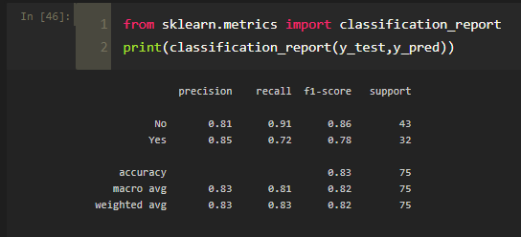
Classification Report:

Slide 44
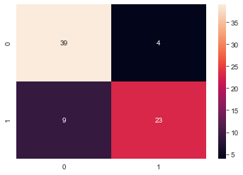
Confusion Matrix

Slide 45
Thank You!
By Mohammed Faraz Hussain
Terna Engineering College, Nerul
ID: TU3F1920077
Roll No.: TE-B-24

Slide 46
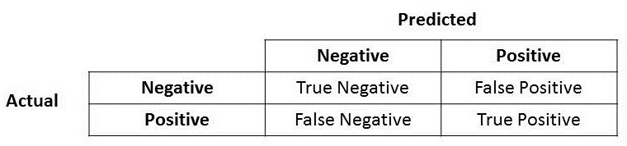
Confusion Matrix

Slide 47
Confusion Matrix:
True Positive (TP) — model correctly predicts the positive class (prediction and actual both are positive). In the above example, 10 people who have tumors are predicted positively by the model.
True Negative (TN) — model correctly predicts the negative class (prediction and actual both are negative). In the above example, 60 people who don’t have tumors are predicted negatively by the model.
False Positive (FP) — model gives the wrong prediction of the negative class (predicted-positive, actual-negative). In the above example, 22 people are predicted as positive of having a tumor, although they don’t have a tumor. FP is also called a TYPE I error.
False Negative (FN) — model wrongly predicts the positive class (predicted-negative, actual-positive). In the above example, 8 people who have tumors are predicted as negative. FN is also called a TYPE II error.

Slide 48
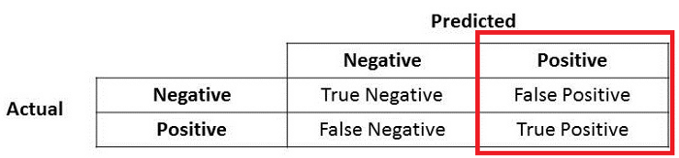
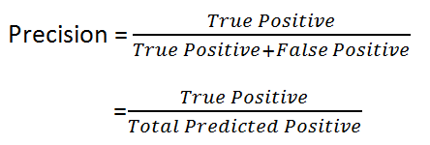
Precision:
Precision talks about how precise/accurate your model is out of those predicted positive, how many of them are actual positive.
Notes:
Precision is a good measure to determine, when the costs of False Positive is high.
For instance,
In email spam detection, a false positive means that an email that is non-spam (actual negative) has been identified as spam (predicted spam).

Slide 49
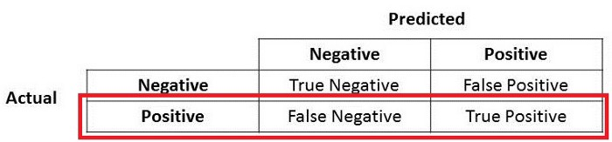
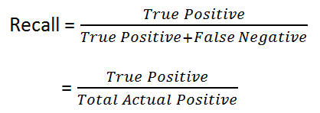
Recall:
Recall actually calculates how many of the Actual Positives our model capture through labeling it as Positive (True Positive)
Notes:
For instance, in fraud detection or sick patient detection.
If a fraudulent transaction (Actual Positive) is predicted as non-fraudulent (Predicted Negative)
Similarly, in sick patient detection. If a sick patient (Actual Positive) goes through the test and predicted as not sick (Predicted Negative).

Slide 50

F1 Score:
F1 Score is needed when you want to seek a balance between Precision and Recall.

